Slide 1
ProfileBook
Developer: Mohammad Oves
Guide: Jyoti Patil Mam

Slide 2
Project Overview
ProfileBook is a full-stack social media platform that enables users to:
- Create and share posts with images
- Interact through likes and comments
- Send direct messages to other users
- Search and discover new users
- Report inappropriate behavior

Slide 3
Project Goals and Objectives
- Primary Goal: Develop a full-stack social media platform with comprehensive admin management
- User Management: Implement secure user registration, authentication, and profile management
- Content Management: Create post creation, approval workflow, and content moderation system
- Administrative Control: Build admin dashboard for user management, content approval, and reporting
- Group Functionality: Enable users to create and manage groups with messaging capabilities

Slide 4
Technical Architecture
Frontend:
- Angular 17+ with TypeScript
- Bootstrap 5 for responsive design
- JWT-based authentication
- Real-time user interactions
Backend:
- ASP.NET Core 9.0 Web API
- Entity Framework Core (Code First)
- SQL Server database
- Swagger API documentation

Slide 5
User Experience Features
User Registration & Authentication
Social Interactions
Content Management

Slide 6
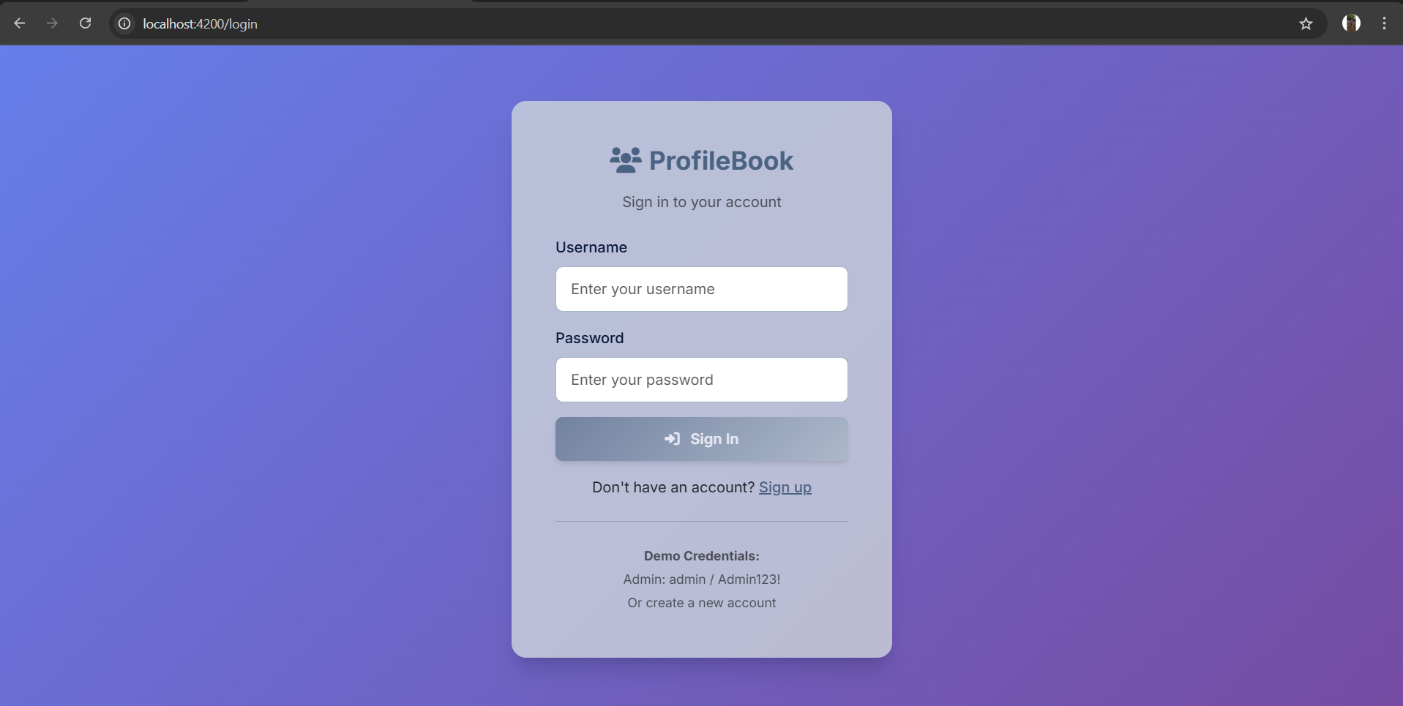
Login page

Slide 7
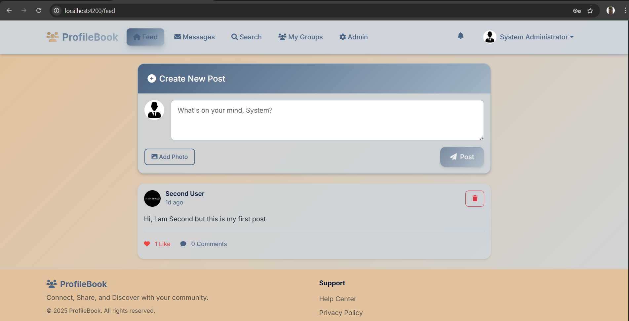
Feed

Slide 8
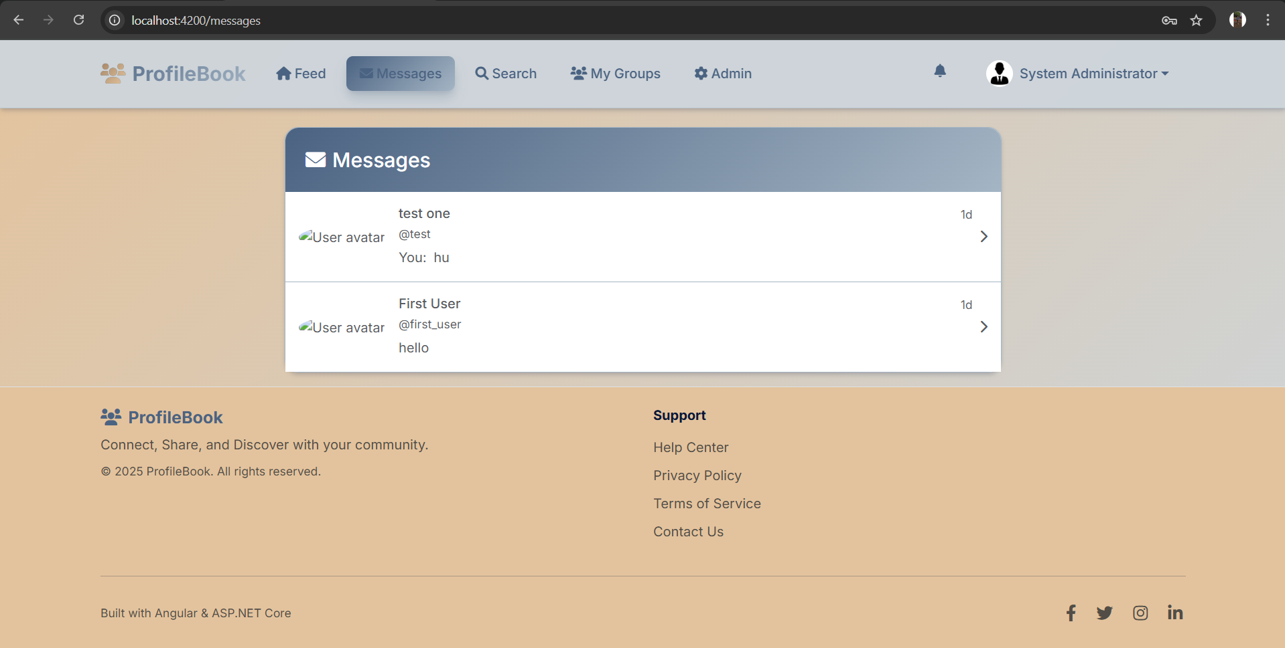
messages

Slide 9
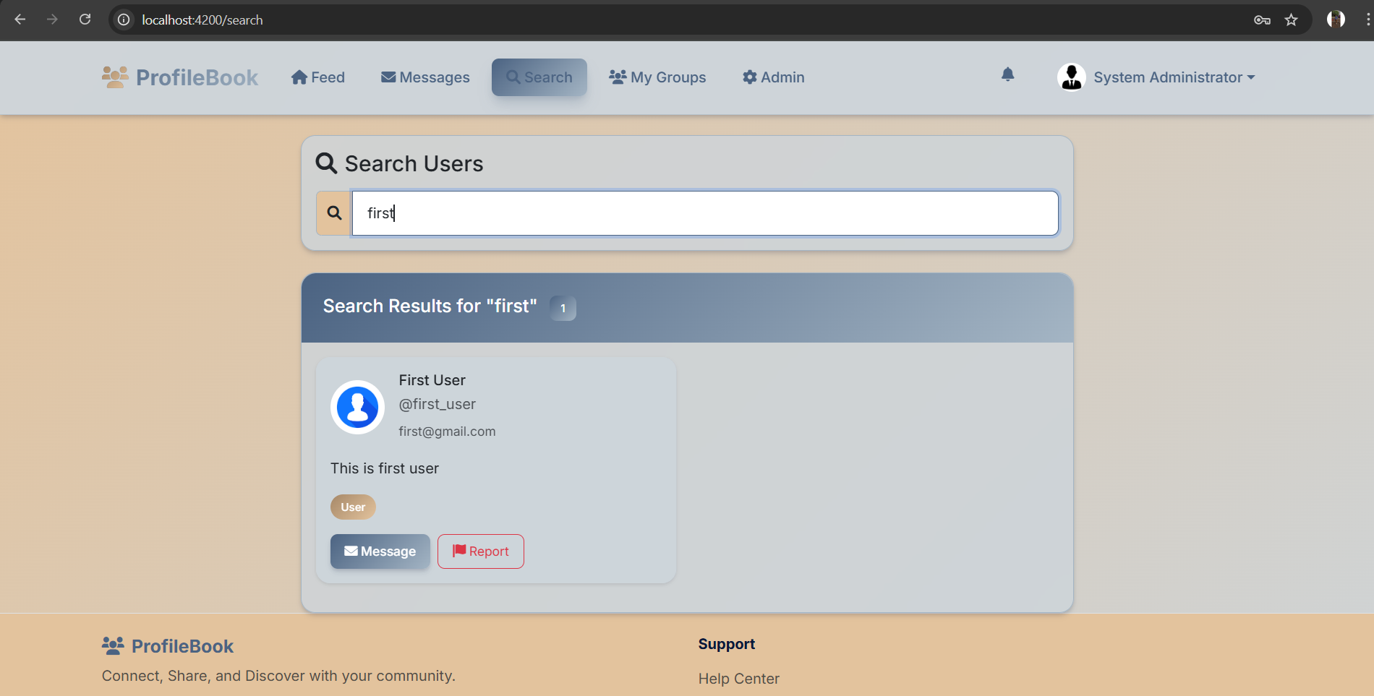
search

Slide 10
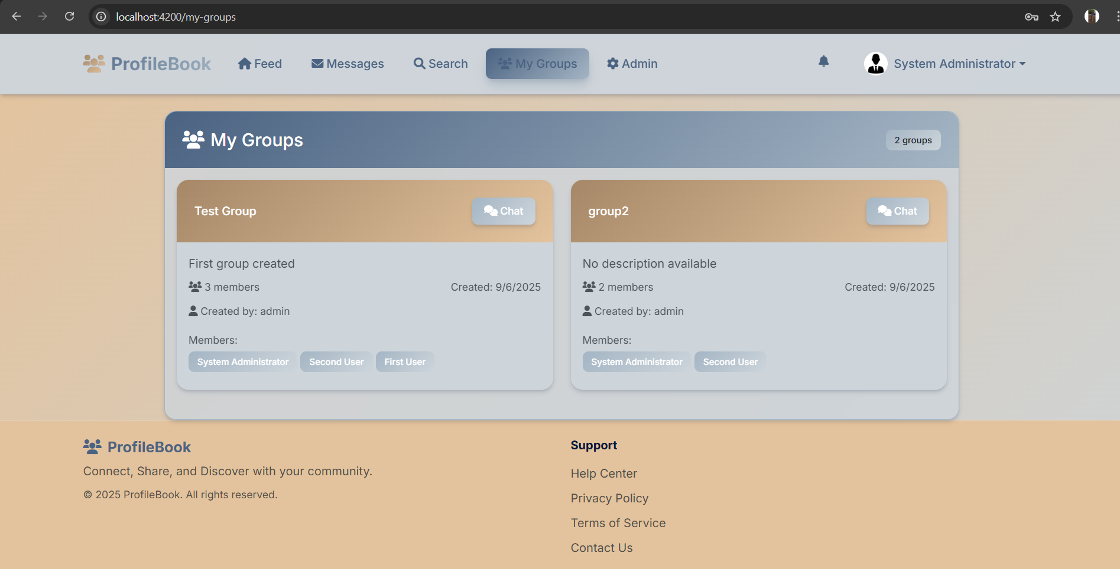
groups

Slide 11
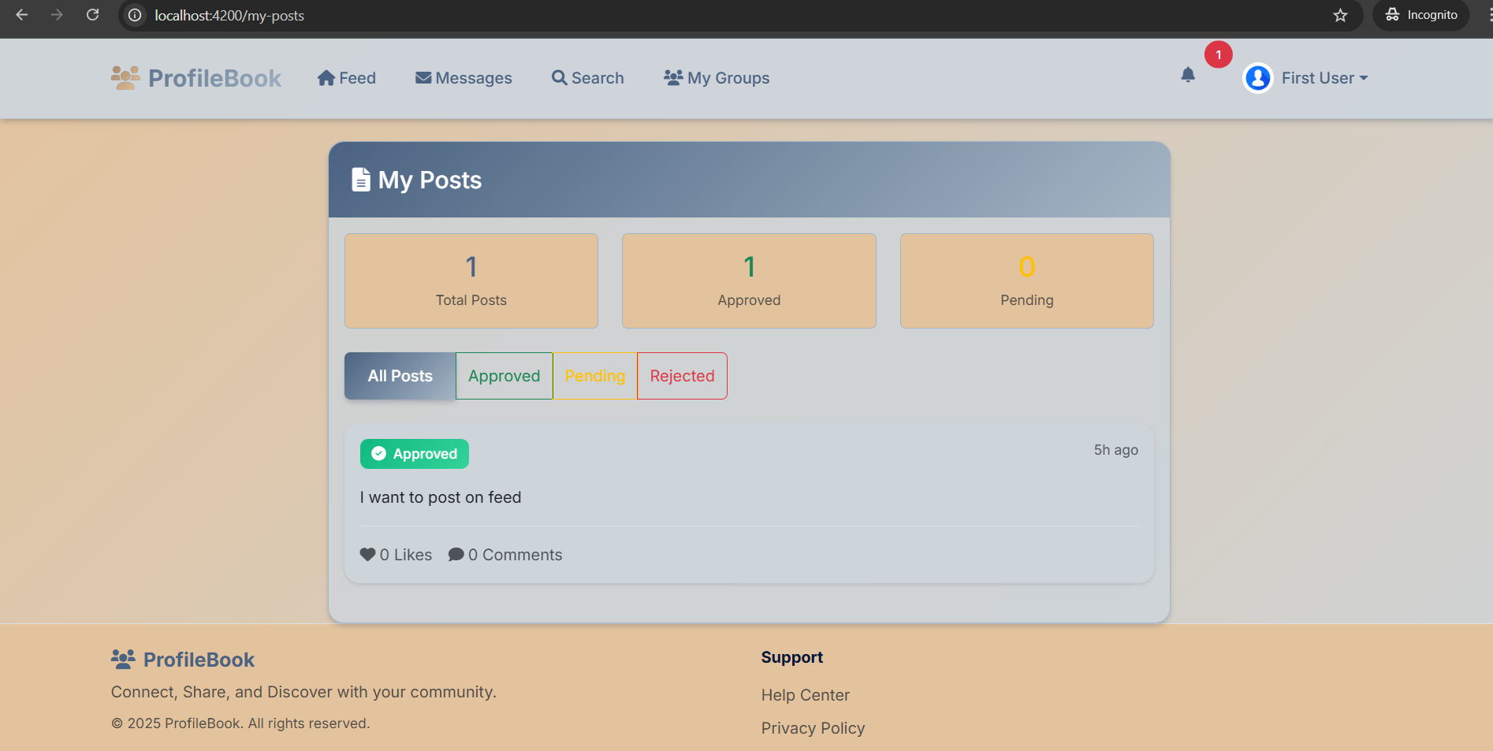
User post-dash

Slide 12
Administrative Control Panel
User Management
Content Moderation
Reporting System
Group Management

Slide 13
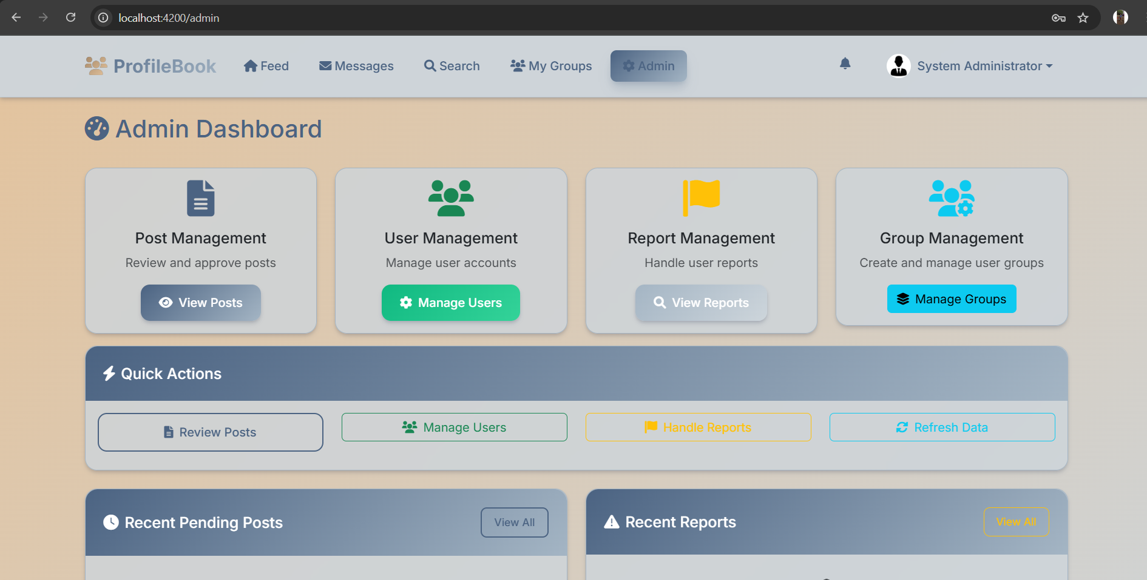
Admin dashboard

Slide 14
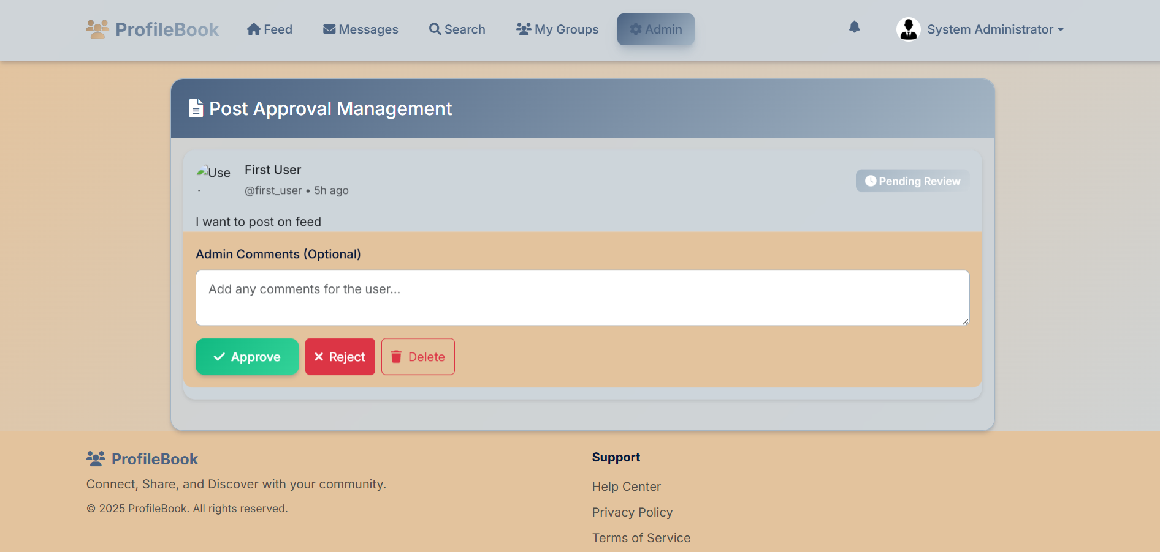
Post approve

Slide 15
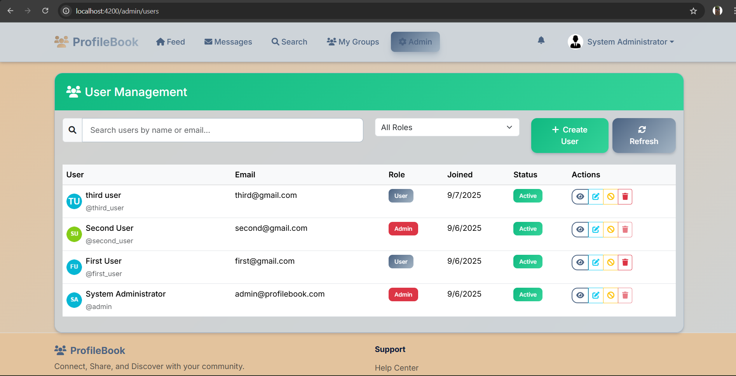
User management

Slide 16
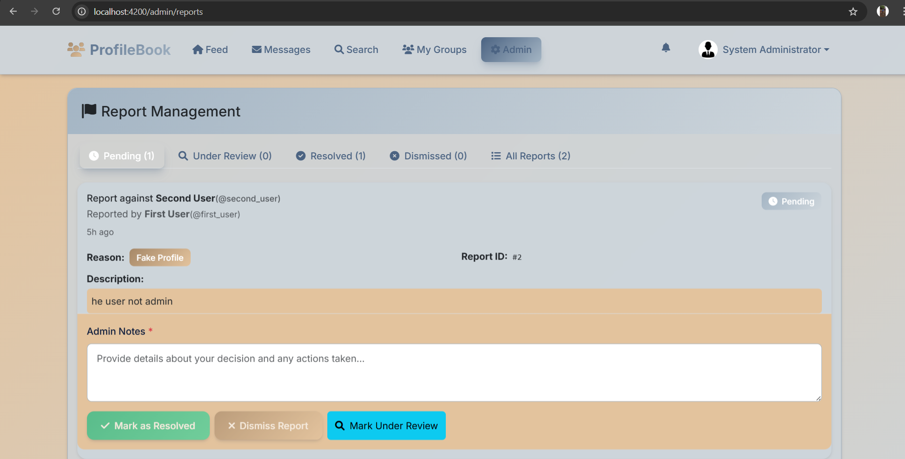
Report management

Slide 17
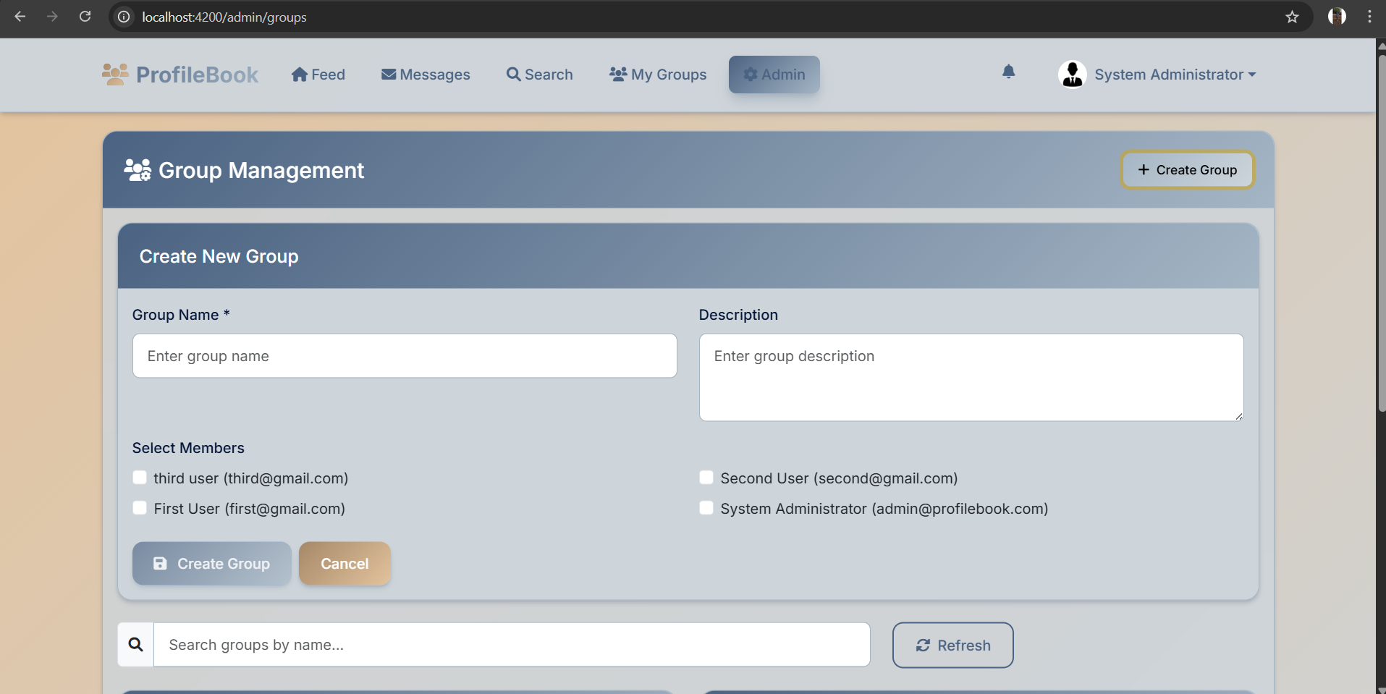
Group management

Slide 18
Frontend Architecture
Component Structure:
- Standalone Angular components
- Lazy-loaded routing modules
- Reactive forms with validation
- HTTP interceptors for auth
User Interface:
- Professional navbar and footer
- Responsive Bootstrap 5 design
- Client-side form validation
- Modern UX/UI principles
State Management:
- Angular services for data
- JWT token management
- Session handling
- Error handling

Slide 19
Security Implementation
Authentication & Authorization
Data Protection: CORS Policy
JWT token authentication
Role-based authorization
Input validation & sanitization

Slide 20
Project Achievements
Database & Schema
Admin Login CRUD
User Registration & Login
Angular Frontend Template
Code Sanitization
CRUD Functionalities
Responsiveness & Validation
Session Handling
Frontend-Backend Integration
Testing

